Slide 1
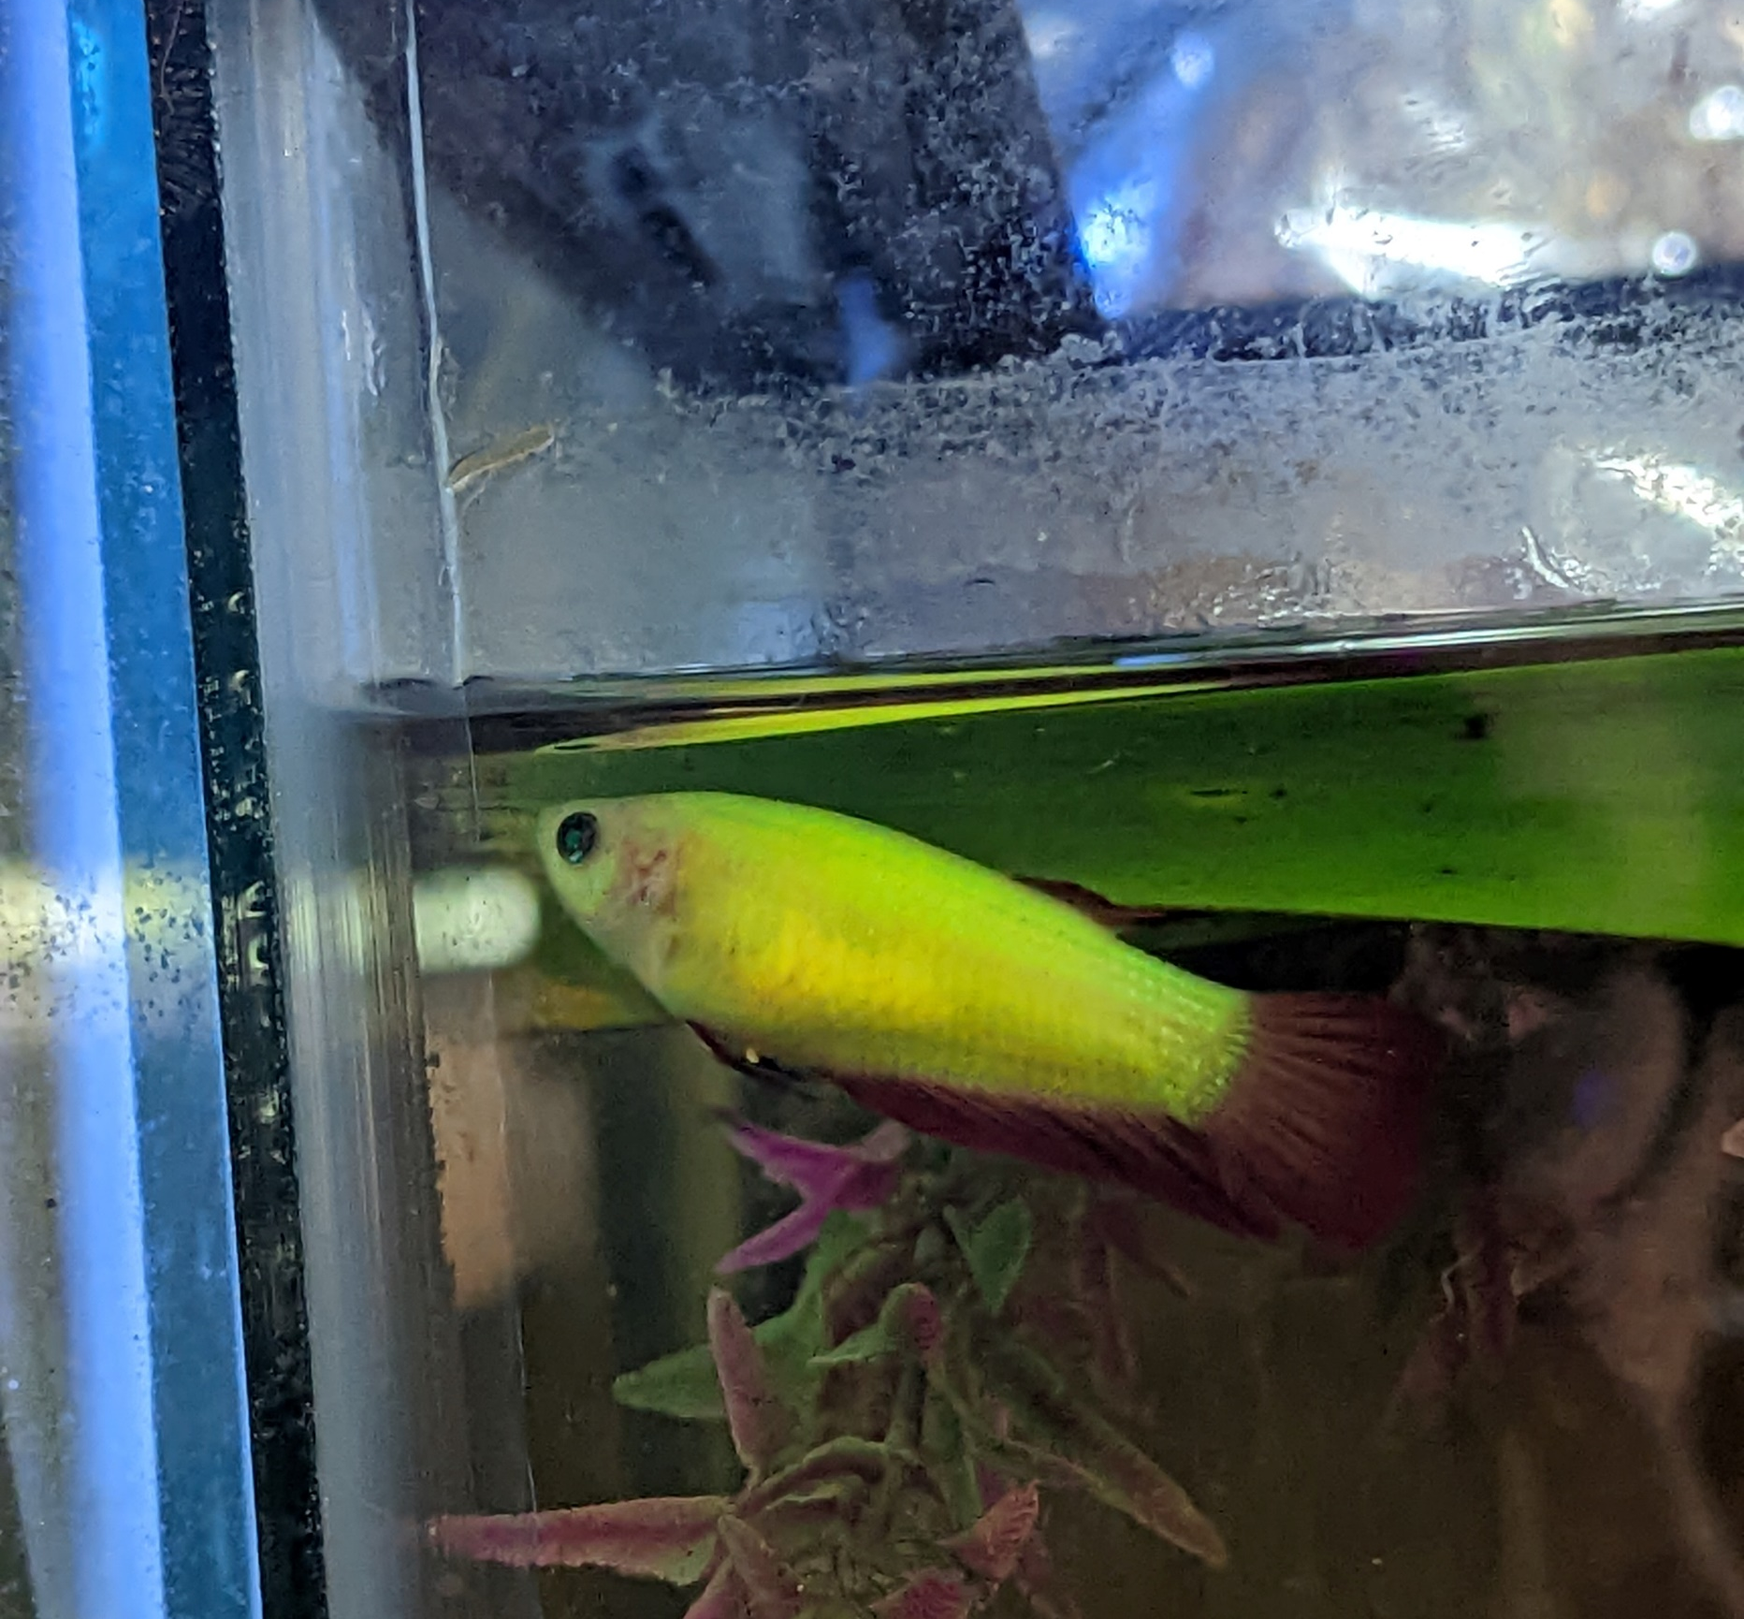
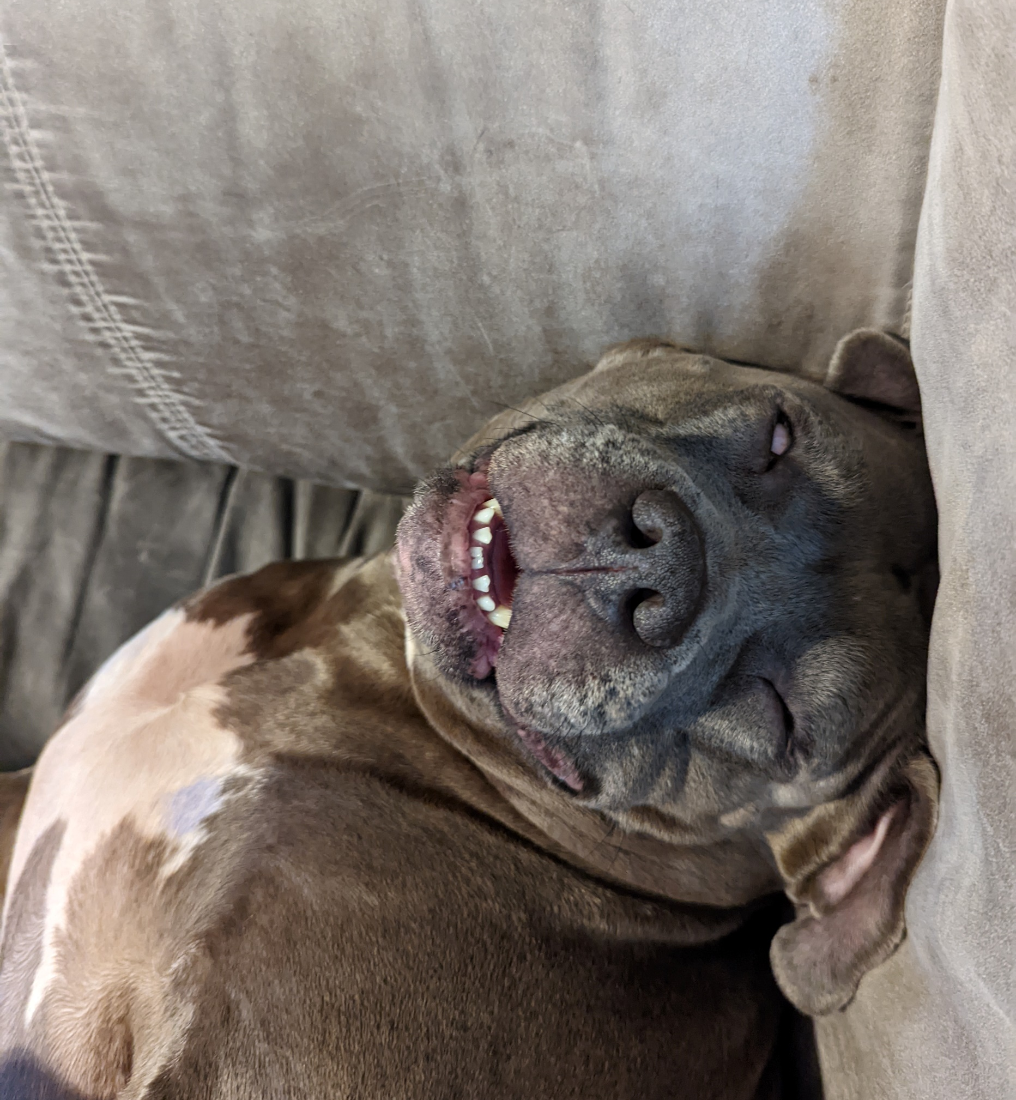
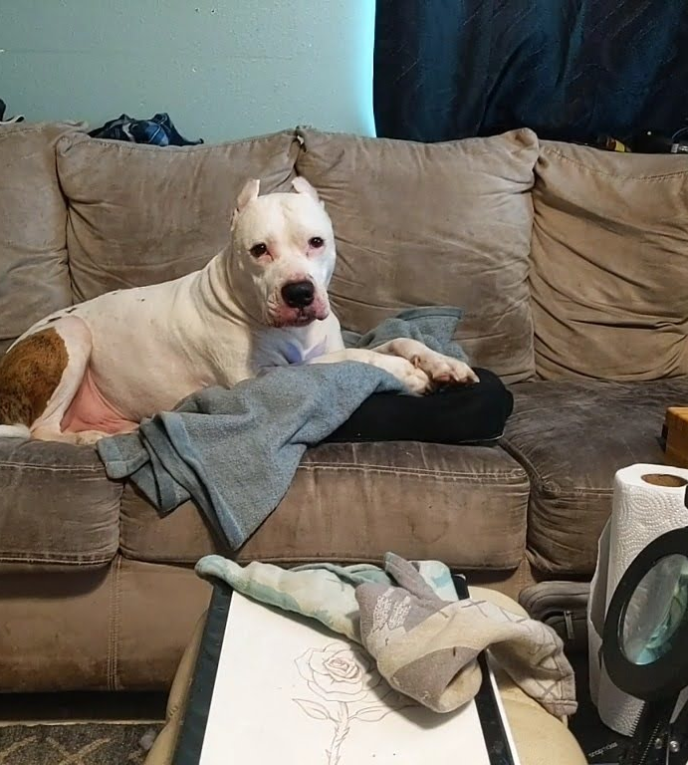

R Lab Week 5: Plotting
Tina
American Staffordshire Terrier
Bronson
American Pitbull Terrier
Kuchi Kopi
Glow Betta
L Burleigh
9/23/2022
BEFORE WE BEGIN
Download ‘add_errorbars.R’ from Moodle Lab 5 materials
Move ‘add_errorbars.R’ to your current working directory for today!
Add to our playlist:

Slide 2
Lab Objectives
Make histograms
Create scatter and bar plots
Add specifications [legends, error bars]
Edit details

Slide 3
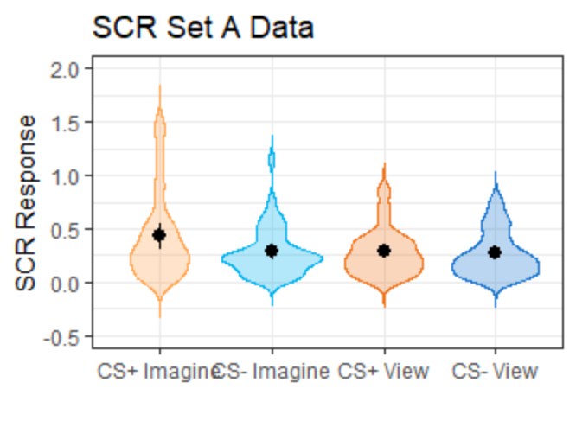
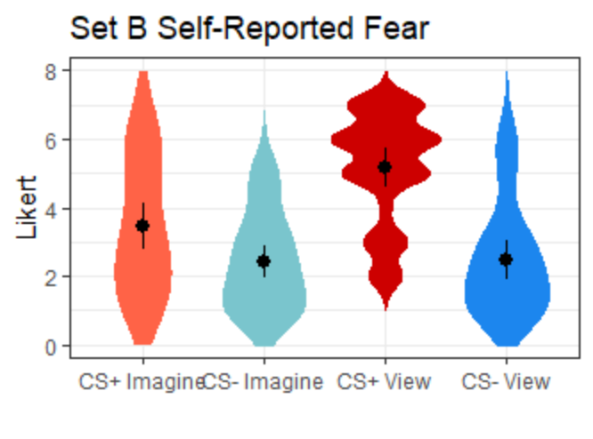
Ggplot Examples

Slide 4
Helpful Code
Task | Code

